Slide 1


Courier Management System
Course Code: CSE-406
Course Title: Integrated Design Project II
Presented To:
Name: Md. Noyan Ali
Designation: Lecturer
Green University of Bangladesh
Presented By:
Name: Estiak Hasan Emon
ID: 201002059
Name: Shamima Aktar
ID: 201002265
Department of Computer Science and Engineering

Slide 2
Outline
01
Introduction
05
Methodology
09
Scope of future work
02
Objectives
06
DFD Diagram
Conclusion
10
03
Project goals
07
ER Diagram
04
Technology
08
Implementation
19-Jun-23
02
Courier Management System

Slide 3

Introduction
“Courier management system”
Used for daily activities such as booking.
processing, package tracking, dispatch management.
19-Jun-23
03
Courier Management System

Slide 4
Objective
01
To Automation and Efficiency
To Improved Customer Service
02
03
To Real-time Tracking and Visibility
04
To Effective Dispatch Management
19-Jun-23
04
Courier Management System

Slide 5

Project goals
Our goal is to expand trade and commerce within the country linking communications support, extending fastest service in time of urgent needs and creating employment opportunities for unemployed youths which will help in the social and economic development of the country.
19-Jun-23
05
Courier Management System

Slide 6

Technology Used
Web Server: XAMP, Sublime Text Editor
04
Back end: MySQL
03
Front end: PHP, HTML, CSS
02
Platform: Windows professional
01
19-Jun-23
06
Courier Management System

Slide 7
Methodology
Admin
Dashboard
Add new
Branch
List
Manage Account
Branch Staff
Add new
Parcels
List
Logout
Track Parcels
User
Reports
19-Jun-23
07
Courier Management System

Slide 8
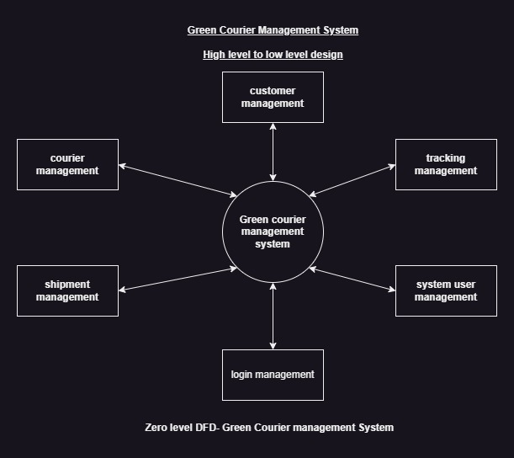
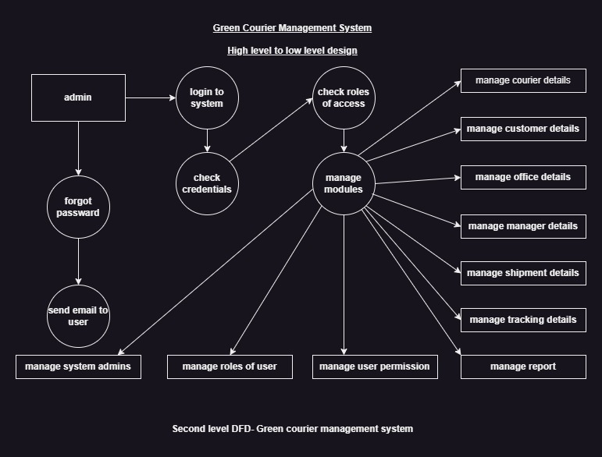
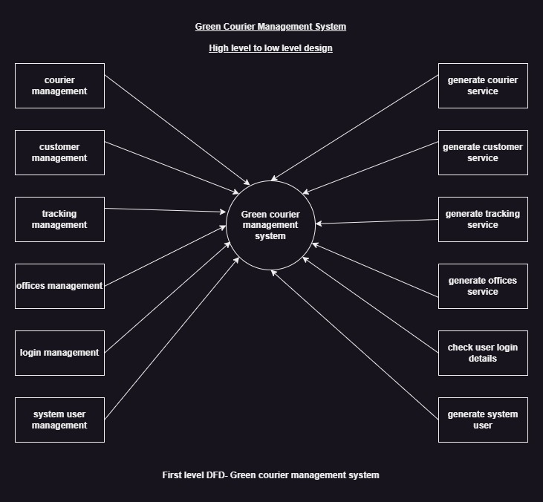
DFD-Diagram
19-Jun-23
08
Courier Management System

Slide 9
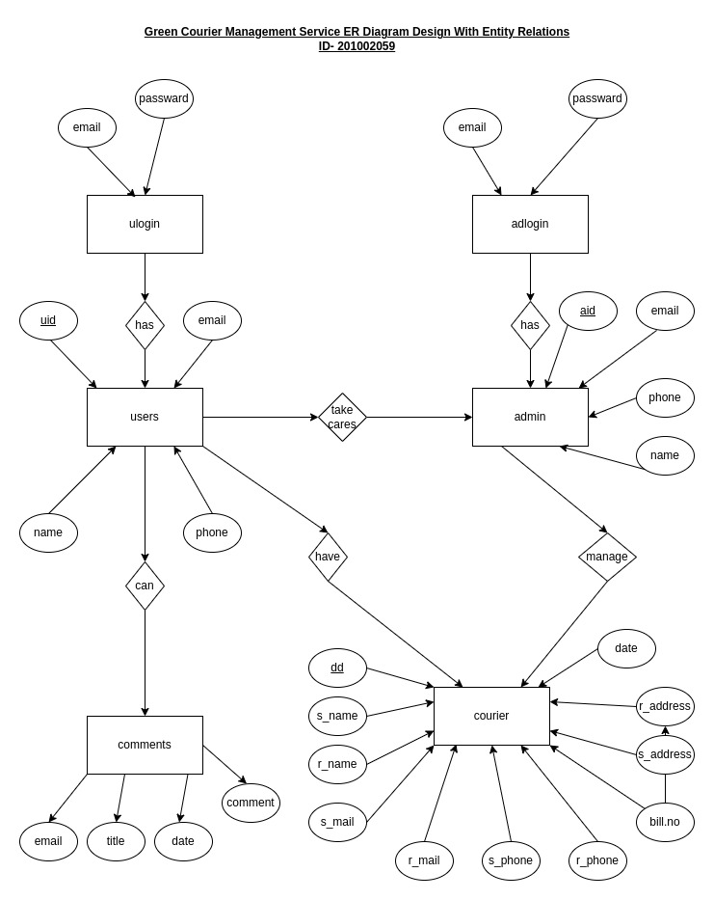
ER-Diagram
19-Jun-23
09
Courier Management System

Slide 10
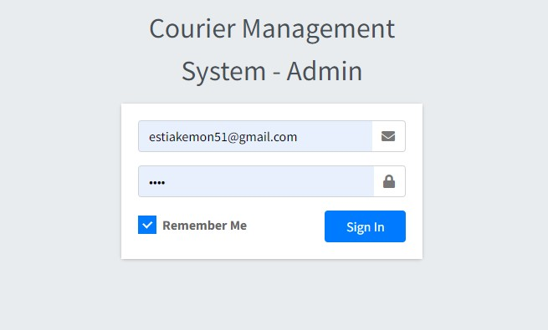
Log in module
19-Jun-23
10
Courier Management System

Slide 11
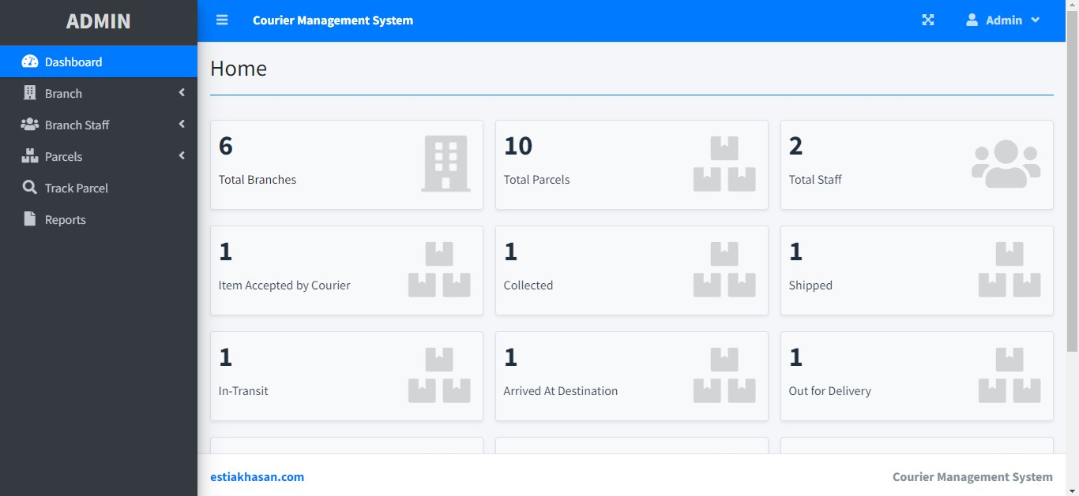
Homepage
19-Jun-23
11
Courier Management System

Slide 12
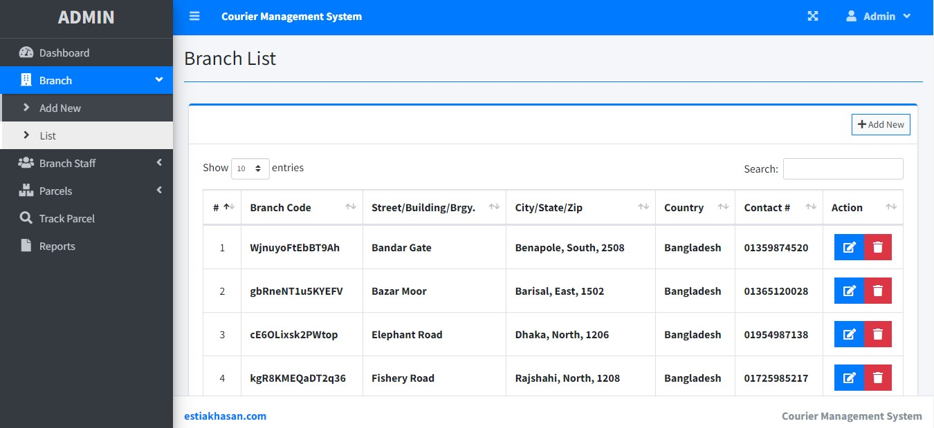
Branch
19-Jun-23
12
Courier Management System

Slide 13
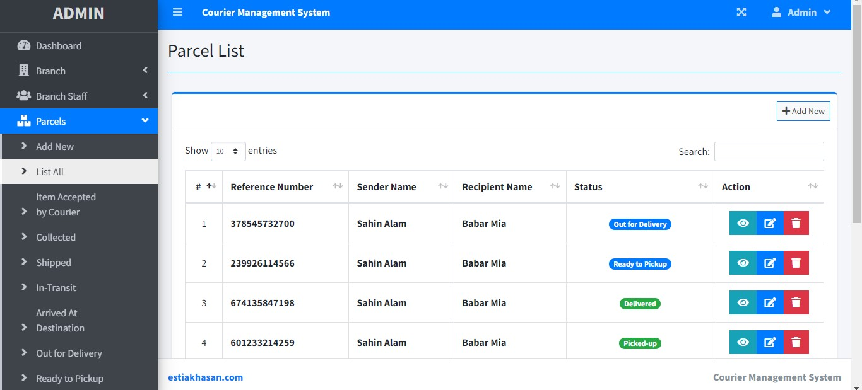
Parcel
19-Jun-23
13
Courier Management System

Slide 14
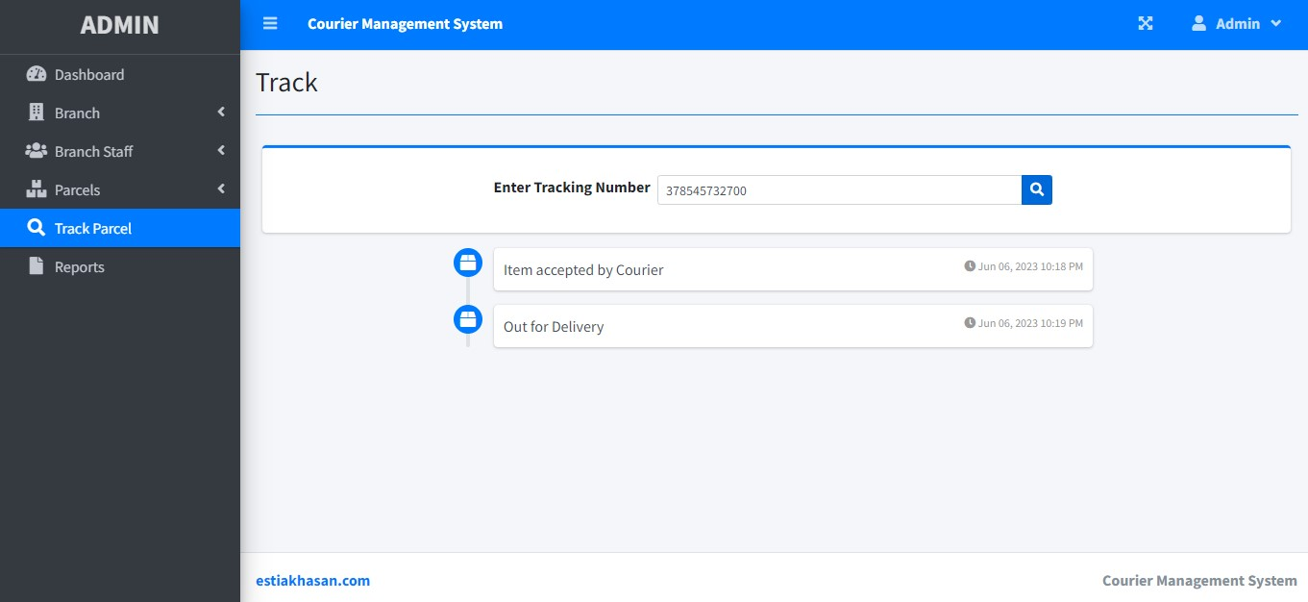
Tracking
19-Jun-23
14
Courier Management System

Slide 15
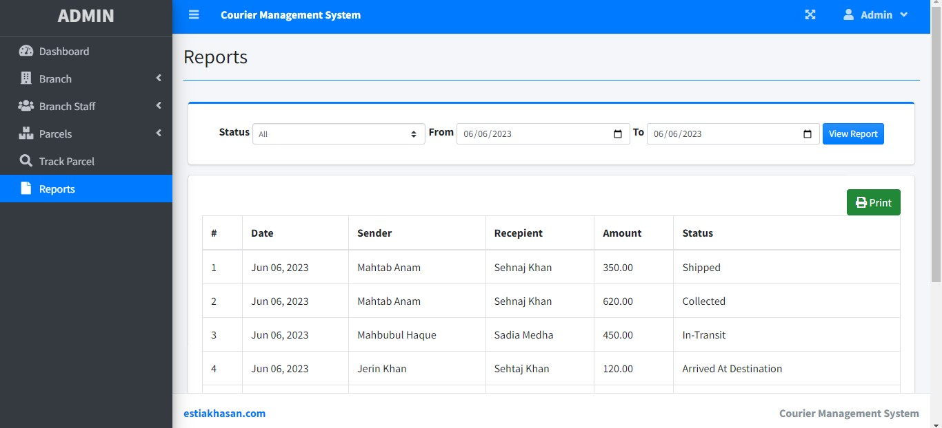
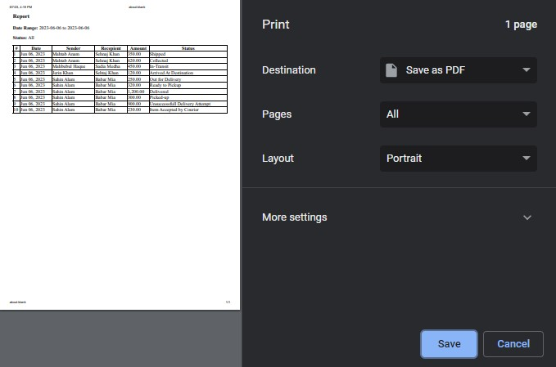
Report
19-Jun-23
15
Courier Management System

Slide 16
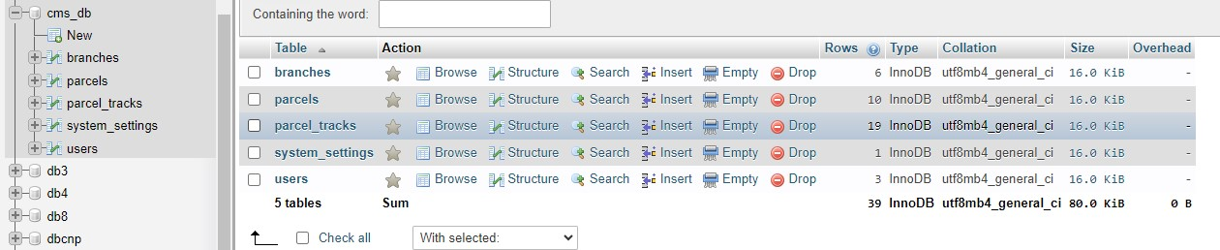
Database connection
19-Jun-23
16
Courier Management System

Slide 17

Scope of future work
01. Integration with E-commerce Platforms.
02. Mobile Applications.
03. Route Optimization.
04. Integration with Third-Party Services.
17
19-Jun-23
Courier Management System

Slide 18
Conclusion
Courier Management System is a comprehensive software solution.
Courier companies can benefit from improved operational efficiency, enhanced customer satisfaction, optimized resource utilization, and data-driven decision-making.
19-Jun-23
18
Courier Management System

Slide 19
Reference
[1] https://slidesgo.com/
[2] https://shipox.com/
[3] https://www.freepik.com/free-photos-vectors/delivery
[4] https://www.clipartmax.com/middle/m2i8d3m2Z5Z5G6d3_reinventing-courier-and-freight-online-courier-management-system/
[5] https://www.vecteezy.com/free-vector/courier
19-Jun-23
19
Courier Management System

Slide 20
Any Question?
20
Courier Management System

Slide 21
Thank You!
21
Courier Management System

